Slide 1
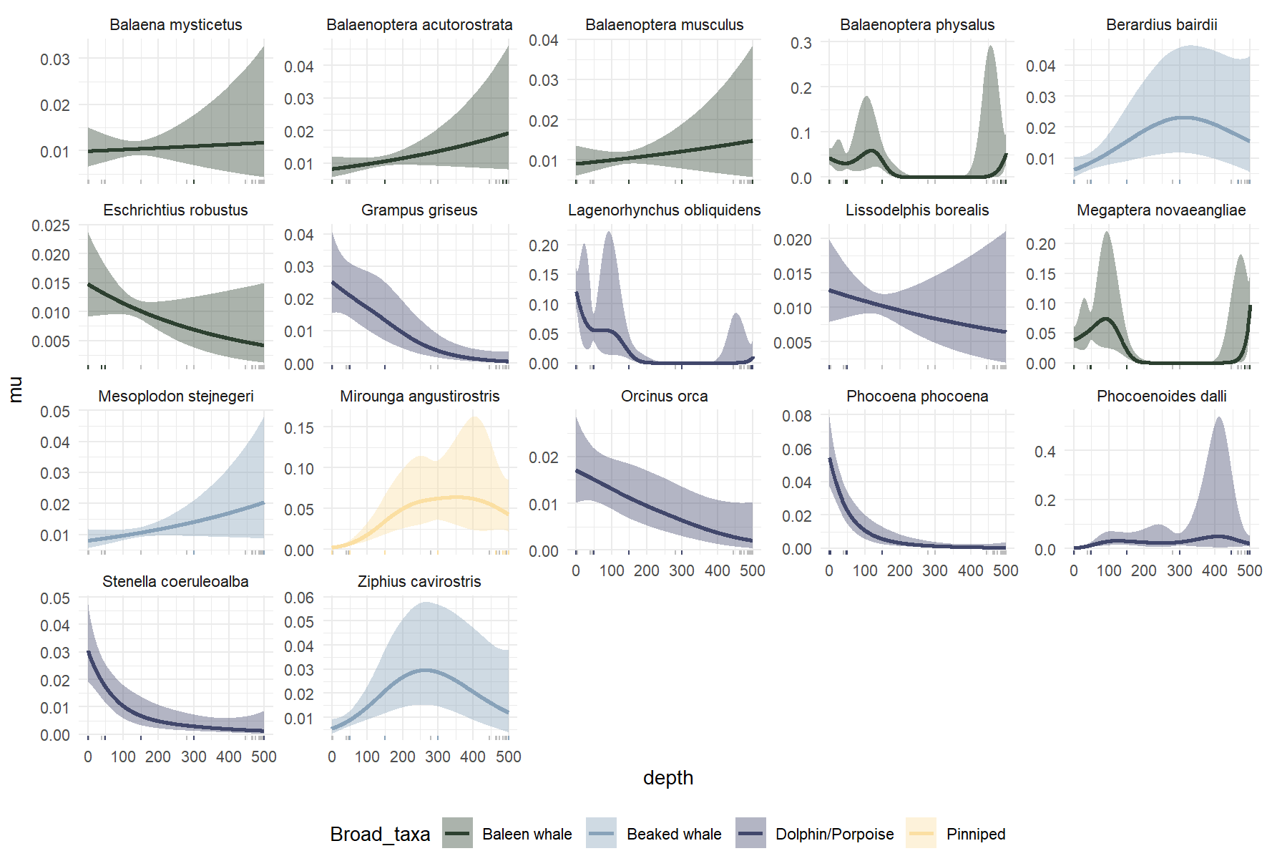
All detects

Slide 2
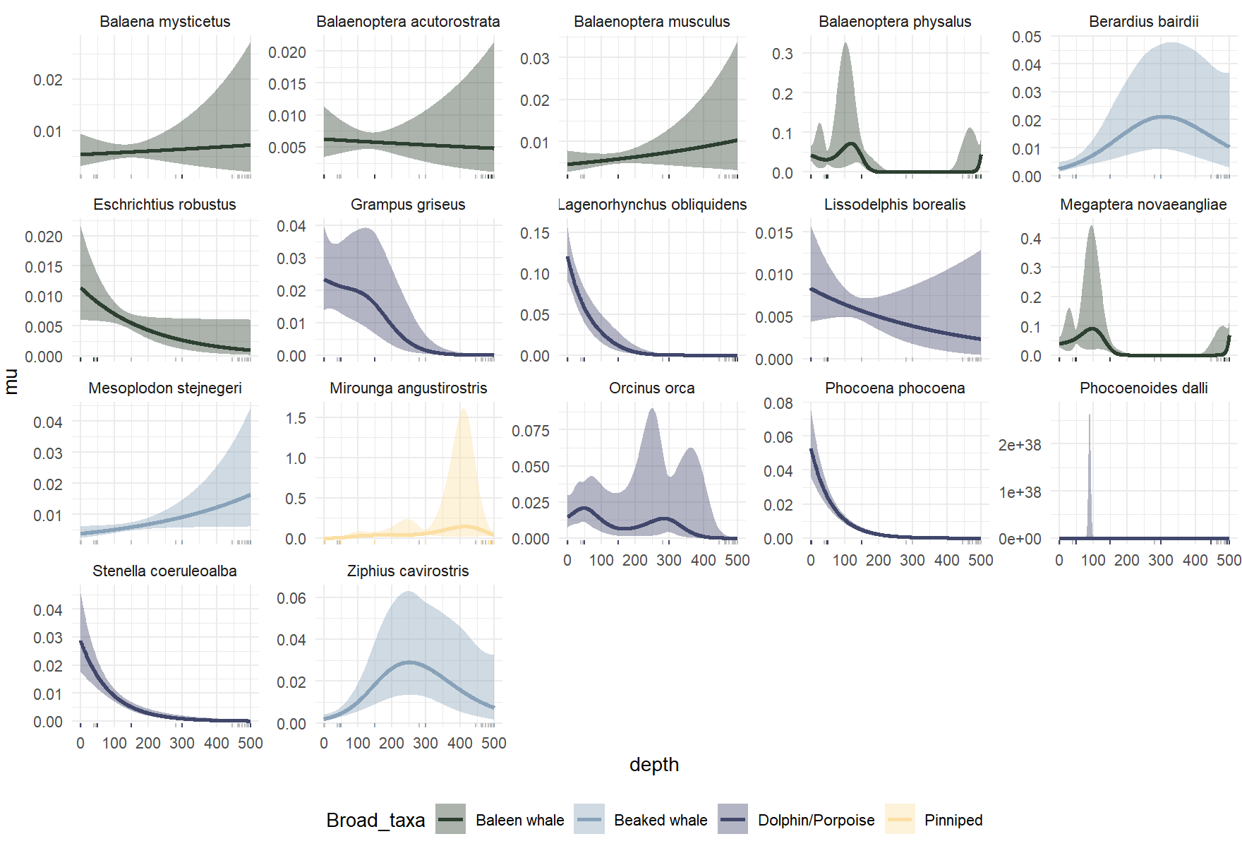
No “whalefall”

Slide 3
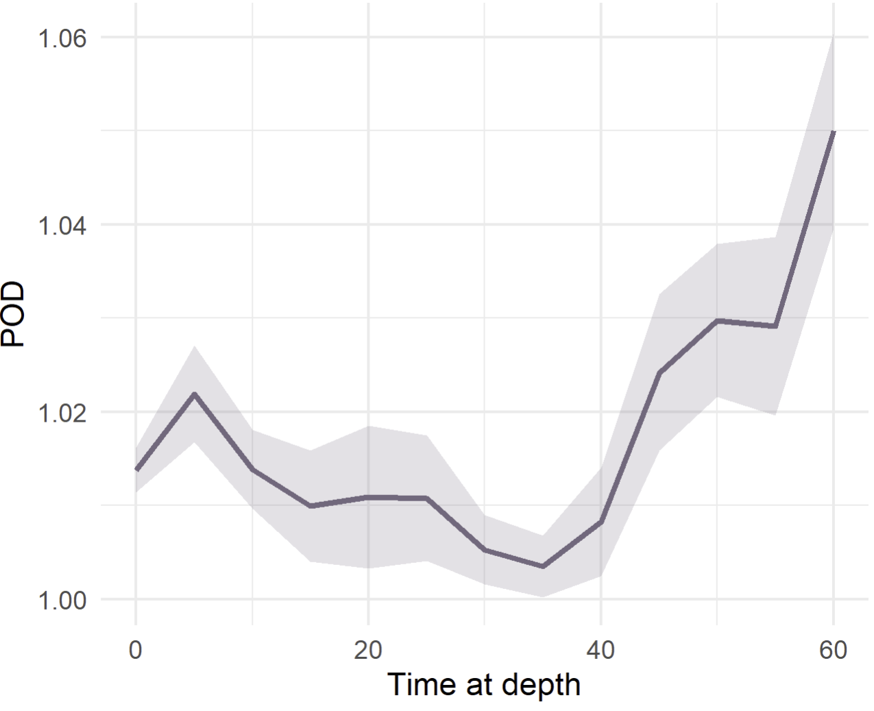
POD ~ time at depth (10 m bins, all species aggregated)

Slide 4
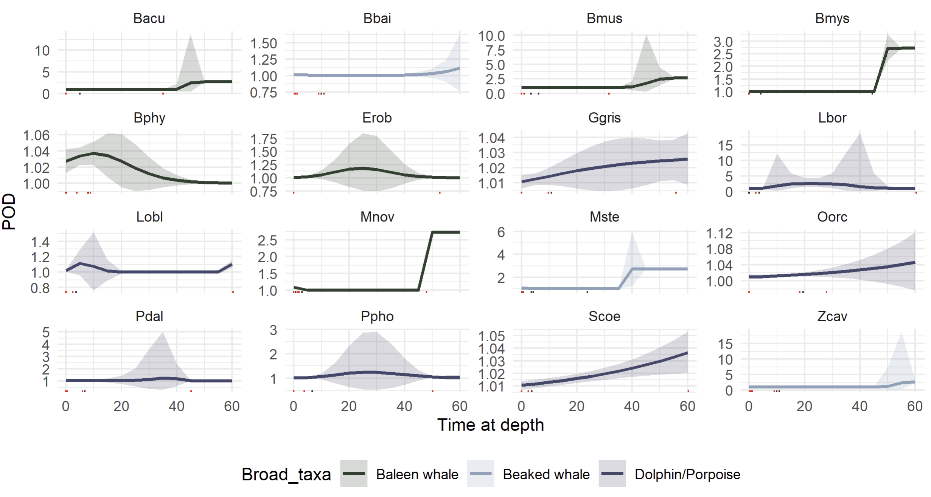
POD ~ time at depth (10m depth bins)

Slide 5
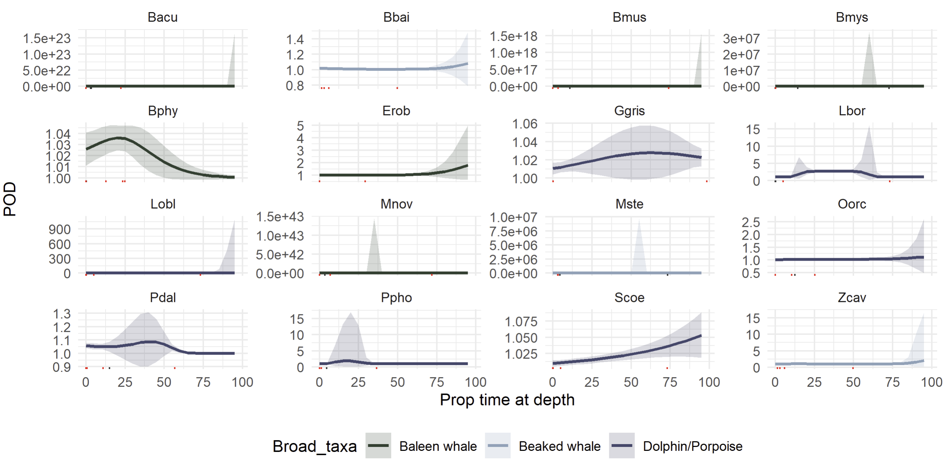
POD ~ time at depth (10 equal observation bins)

